Slide 1

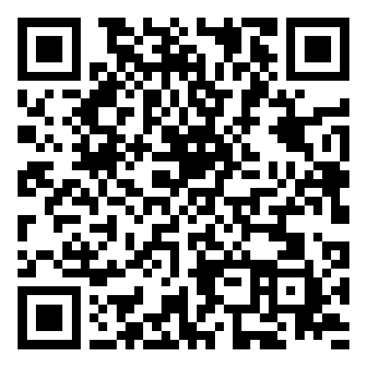
Machine Learning overview
www.aiasaanhai.com

Slide 2

Introduction to Machine Learning
Definition: Machine learning is a subset of artificial intelligence (AI) that provides systems the ability to automatically learn and improve from experience without being explicitly programmed.
Focus: Development of computer programs that can access data and use it to learn for themselves.
Photo: turned on MacBook Air on desk
Photo by Goran Ivos
Powered by Unsplash

Slide 3
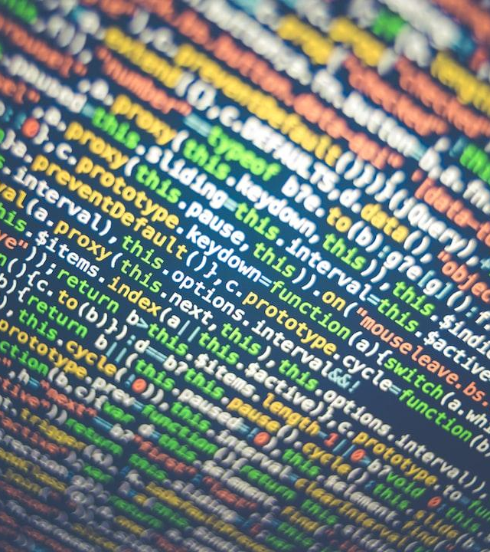
Supervised Learning
Explanation: Involves training a model on a labeled dataset to predict outputs from input data.
Python Example: Linear Regression code snippet.
Photo: tilt-shift photography of HTML codes
Photo by Markus Spiske
Powered by Unsplash

Slide 4
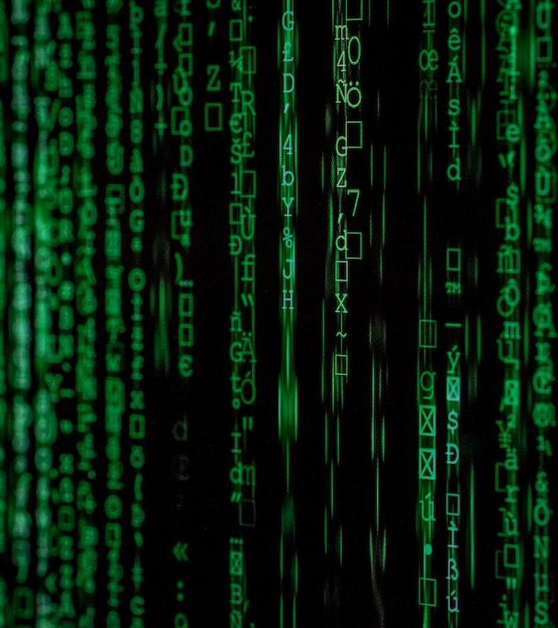
Unsupervised Learning
Explanation: Involves training a model on data that is not labeled, allowing the model to discover patterns.
Python Example: K-Means Clustering code snippet.
Photo: Matrix movie still
Photo by Markus Spiske
Powered by Unsplash

Slide 5

Neural Networks and Deep Learning
Basic Concepts: Algorithms modeled loosely after the human brain, designed to recognize patterns.
Python Example: Simple Neural Network with TensorFlow code snippet.
Photo: a heart is shown on a computer screen
Photo by Alexander Sinn
Powered by Unsplash

Slide 6

Overfitting and Underfitting
Explanation: Overfitting is learning too much detail and noise, underfitting is failing to capture underlying trends.
Python Example: Regularization Techniques code snippet.
Photo: closeup photo of eyeglasses
Photo by Kevin Ku
Powered by Unsplash

Slide 7
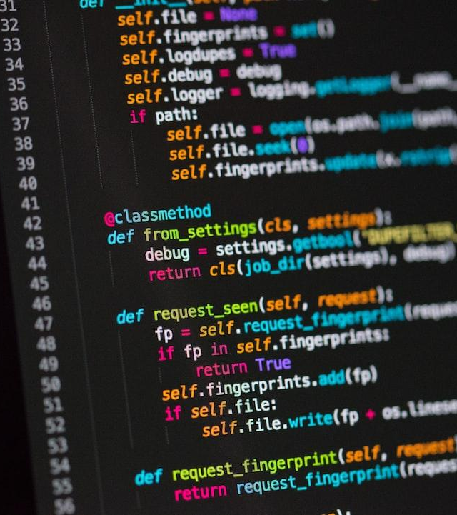
Model Evaluation and Validation
Explanation: Using metrics to understand a model's performance and testing it on a separate dataset.
Python Example: Using scikit-learn for Model Evaluation code snippet.
Photo: a computer screen with a bunch of code on it
Photo by Chris Ried
Powered by Unsplash

Slide 8
Thanks.

